Slide 1
E-COMMERCE COMPARISON
-Sowmya

Slide 2
PROJECT OVERVIEW
What are the Application
- Amazon, Croma
Why automation
- Manual testing for an e-commerce application like Amazon is time-consuming and repetitive, especially during regression testing.

Slide 3
Requirements
Browser | Amazon,Croma
Close | Popups
Products | Electronics
Search | Iphone 15
Comparison | Cost
Navigate | Lowest site
Assertions | Validation

Slide 4
Objectives
Reduce manual effort
Increase regression coverage
Reusable framework
Faster execution

Slide 5
Technology Stack
Java
Selenium
BDD(Cucumber)
TestNG
Page Object Model
Extent Reports
Loggers

Slide 6
POM Overview
Separate class for each page
Locators & methods
Reusability

Slide 7
POM Framework
Feature File
↓
Step Definition
↓
Page Object Model
↓
Utilities
    ( Screenshot, Logger)
↓
    Reports

Slide 8
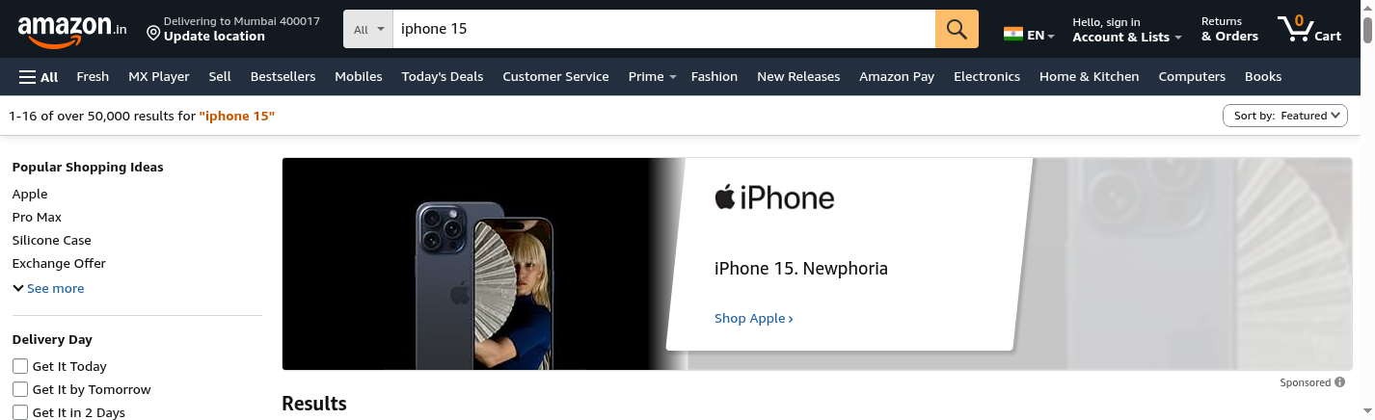
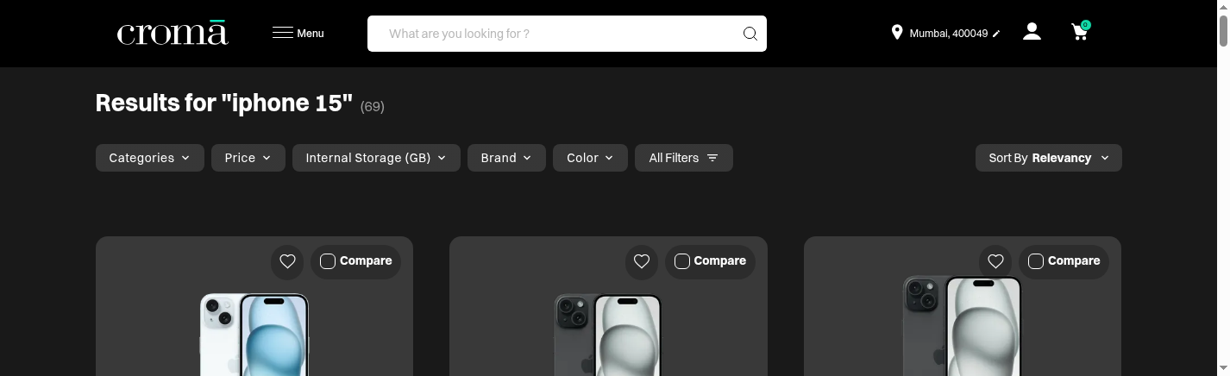
Screenshots

Slide 9
Reports
Extent Report
Screenshot attachment
Pass/Fail logs

Slide 10
Challenges Faced
Dynamic Elements
Synchronization Issues
Handling Popups
Waits Strategies

Slide 11
Conclusion
Automation reduced execution time
Reusable and scalable framework
Easy maintenance

Slide 12
Thank You

